Slide 1

Project Name: Analyzing and Visualizing Regional Sales Performance Domain: Retail Sales Analytics Tool Used: Microsoft Excel Prepared by: MonikaM Institute: Vinsup Skill Academy, Coimbatore

Slide 2
Business Case
Company: ABC Electronics
ABC Electronics operates across multiple regions and sells various product categories. Management wants to understand:
Which region performs best
Which products generate highest sales and profit
How discounts affect sales
Monthly sales trends
The goal is to convert raw sales data into actionable business insights.

Slide 3
Problem Statement
ABC Electronics wants to assess its sales performance across different regions and product categories. Management requires a summarized and visual report to identify:
Top-performing regions
Best-selling product categories
Profitability
Sales trends so that they can take better marketing, pricing and inventory decisions.

Slide 4
Dataset overview
The dataset contains 4000 sales records with the following fields:
Order ID
Order Date
Region
Product Category
Sales Amount
Quantity Sold
Discount (%)
Profit
The data covers sales across East, West, North and South regions.

Slide 5
Data Cleaning Process
The raw data had:
Incorrect region names (norTh, Mes$t, eAsT)
Spacing errors in product names (Cloth ing)
Incorrect percentage format
Blank columns
Cleaning steps performed:
Removed unnecessary columns
Standardized Region & Product Category using TRIM, PROPER
Converted Discount to % format
Removed duplicates
Converted Order Date to Date format
This created a clean, structured dataset ready for analysis.

Slide 6






KPIs Used
The dashboard shows these key performance indicators:
Total Sales: ₹10.1M
Total Profit: ₹4.0M
Top Region: East
Top Product Category: Clothing
Average Discount: 25%
Profit Margin: ~39%
These KPIs give a quick overview of business health.
Total Sales
Total
Profit
Top Region
₹10.1M
₹4.0M
East
Profit Margin
Ave
Discount %
Top Product Category
39.9%
25%
Clothing

Slide 7
Visualization 1. Region Wise Sales Interpretation
The bar chart shows total sales by region.
Observation:
East region has the highest sales
North and South perform moderately
West has the lowest sales
Business Interpretation:
The East region should be prioritized for marketing and expansion.

Slide 8
Category Wise Sales Contribution
The pie chart shows sales contribution by product category.
Observation:
Clothing contributes the highest share
Electronics, Furniture, Groceries, and Sports have similar shares
Business Interpretation: Clothing is the most important revenue driver and should be stocked and promoted more.

Slide 9
Monthly Sales and Profit Trend
The line chart shows monthly sales and profit.
Observation:
Sales remain fairly stable throughout the year
Profit follows a similar pattern
Slight peaks are visible in mid-year and end-year
Business Interpretation: The business has consistent demand, which is a sign of stability.

Slide 10
Sales by Region & Category
The stacked bar chart shows how each product category performs in each region.
Observation:
East leads in most categories
Clothing and Furniture dominate across regions
Business Interpretation: Regional and category-wise strategies can be designed based on this distribution.

Slide 11
Monthly wise quantity Sold
Sales grow from March to August, peak in August, dip in February and September, and rise again towards year-end.
Business Interpretation: Customer demand is strongest in mid-year and during year-end seasons, showing clear seasonal buying behavior.

Slide 12
Discount vs Sales (Regression)
The scatter plot shows the relationship between Discount and Sales.
Regression Result:
R² = 0.0017 (very weak)
Business Interpretation:
Discounts have very little impact on sales. The company should avoid heavy discounts and focus on value and branding instead.

Slide 13
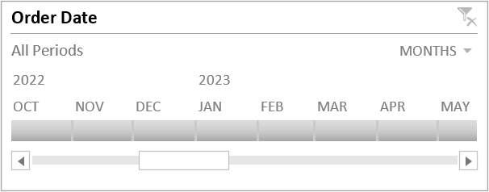
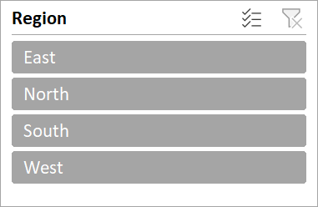
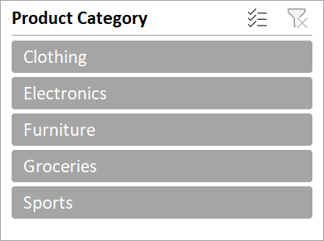
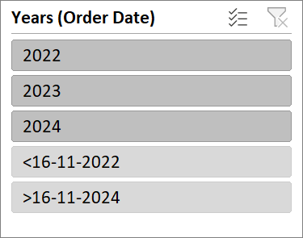
Dashboard
Regional Sales Performance Analysis
Total Sales
Total
Profit
Top Region
₹10.1M
₹4.0M
East
Profit Margin
Ave
Discount %
Top Product Category
39.9%
25%
Clothing

Slide 14
Final Business Recommendations
Focus marketing efforts on East region
Invest more in Clothing category
Reduce unnecessary discounts
Maintain stock for consistently selling products
Use monthly trend to plan inventory

Slide 15
Conclusion
This project converted raw sales data into a powerful visual dashboard that helps:
Identify top-performing regions
Understand product performance
Analyze profitability
Support strategic business decisions
This analysis can be used by ABC Electronics for growth and profitability improvement.

Slide 16
Thank you

